Slide 1
NOTI BY NATURE

Slide 2
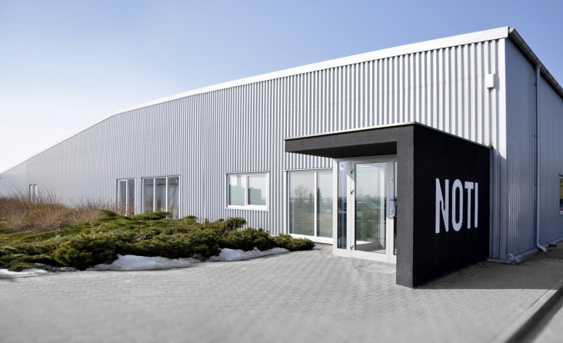
NOTI BY NATURE

Slide 3
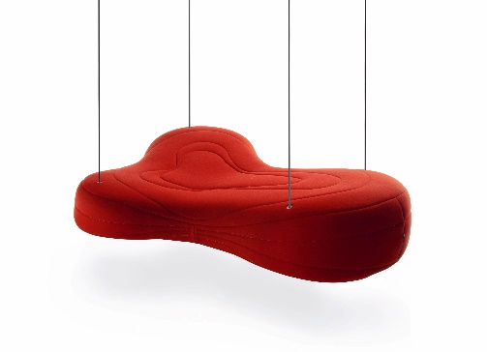
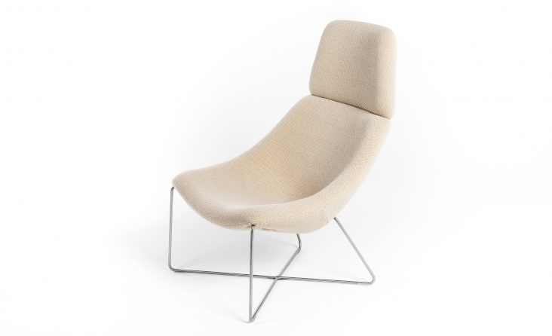
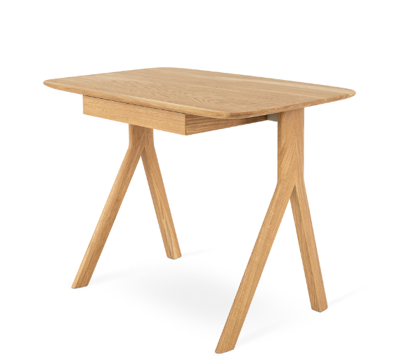
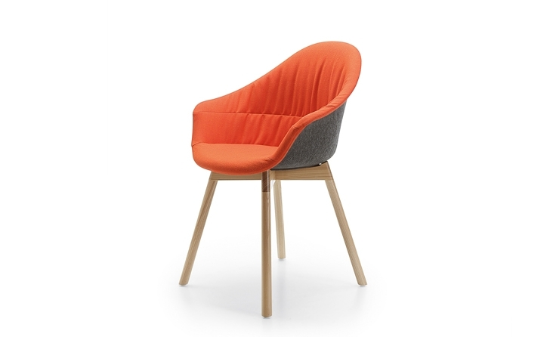
NOTI company
Has existed in the market for over 14 years.
The factory based in Tranowo Podgórne, near Poznań
Original sofas, armchairs, ottomans, chairs and tables.
The furniture dedicated for residential, office and public spaces.
The best Polish designers.
The high quality of materials used.
The professional team, certified and trustworthy suppliers
The honesty and reliability in business
The ecological awareness
NOTI BY NATURE

Slide 4
In the company management, NOTI has always aimed at integrating the company strategy with the environment protection.
business activity with the respect for the environment
The brand development strategy
the environment protection
NOTI BY NATURE

Slide 5
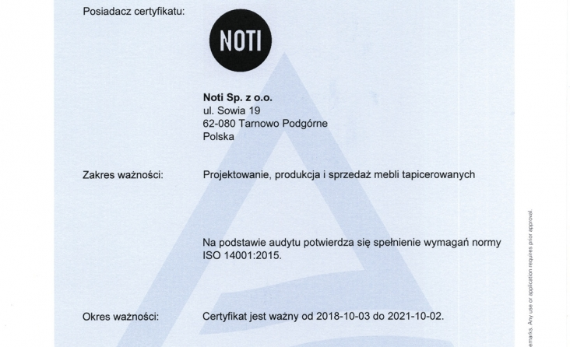
The implemented environment management system according to ISO 14001:2015
NOTI BY NATURE

Slide 6
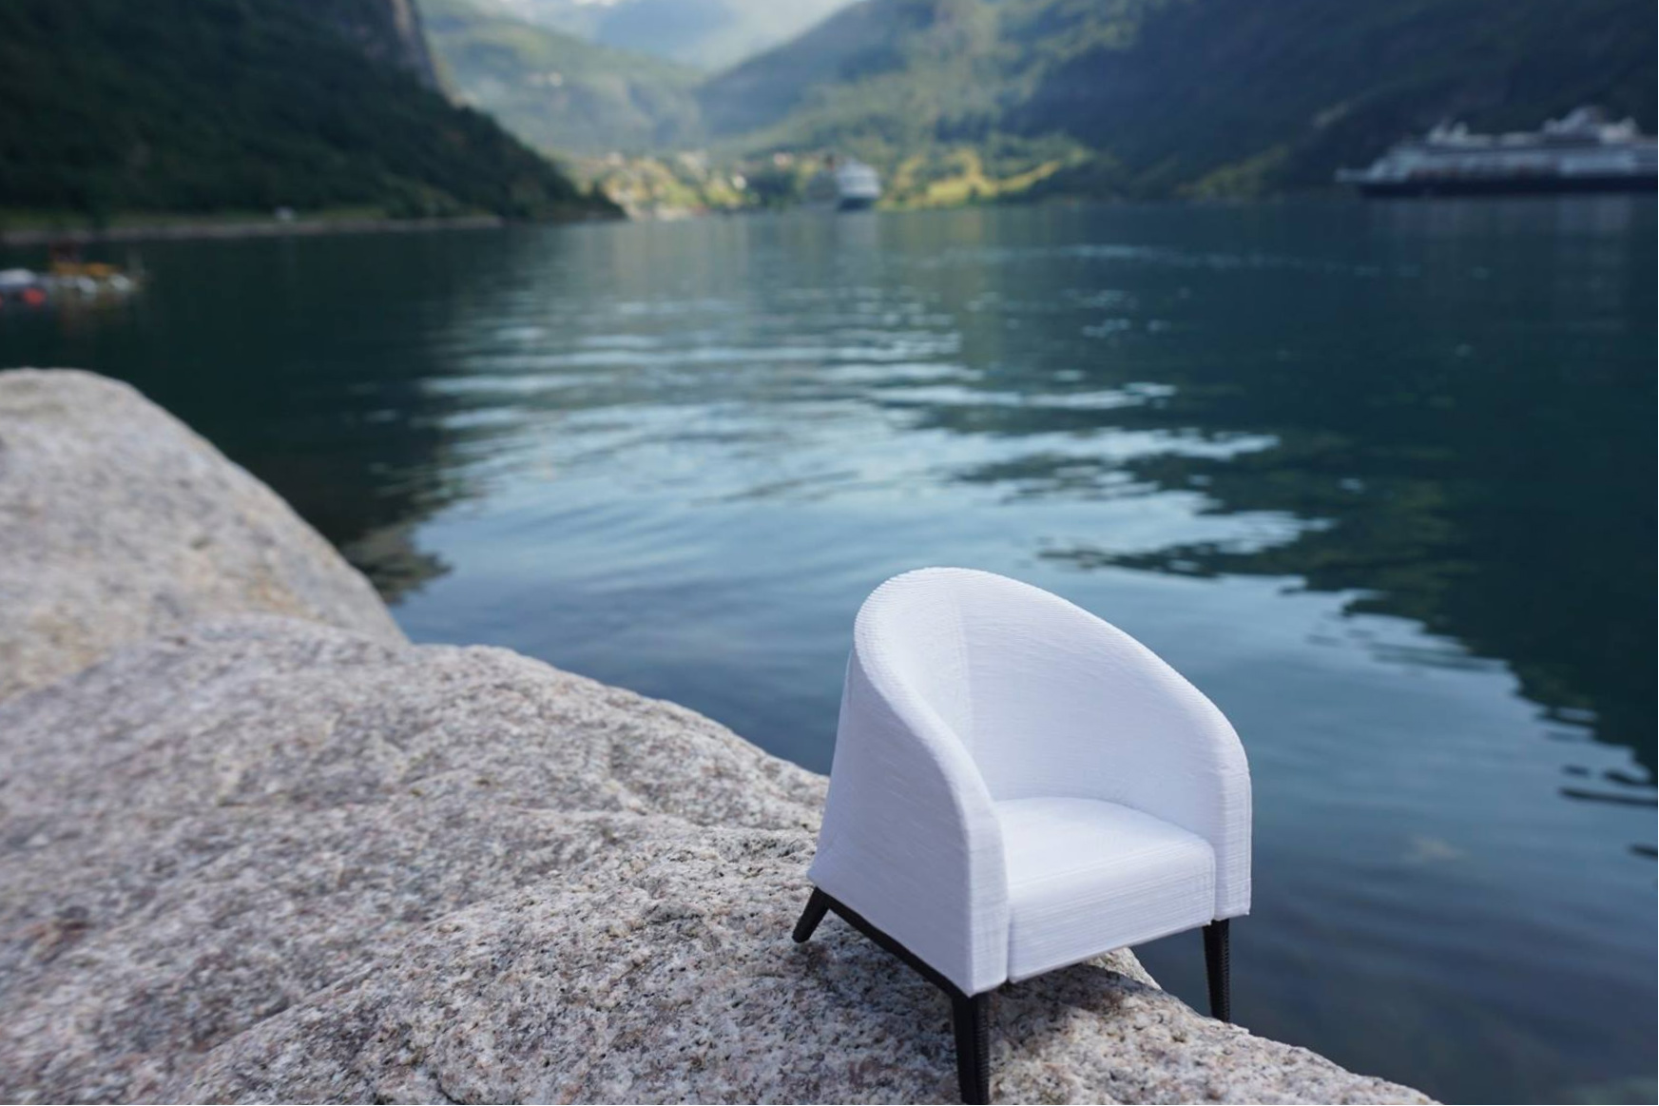
Driven by the principle of sustainable development – a human being is a part of the environment – we embark on pro-ecological actions.
NOTI BY NATURE

Slide 7
We apply products, services and technologies that limit the scale of impacting the environment.
We improve the processes in order to decrease the usage of energy, water, raw materials, materials and fuels.
We comply with law requirements in terms of the environment protection.
We raise ecological awareness among employees.
We anticipate and evaluate the pollution and emission risk.
NOTI BY NATURE

Slide 8
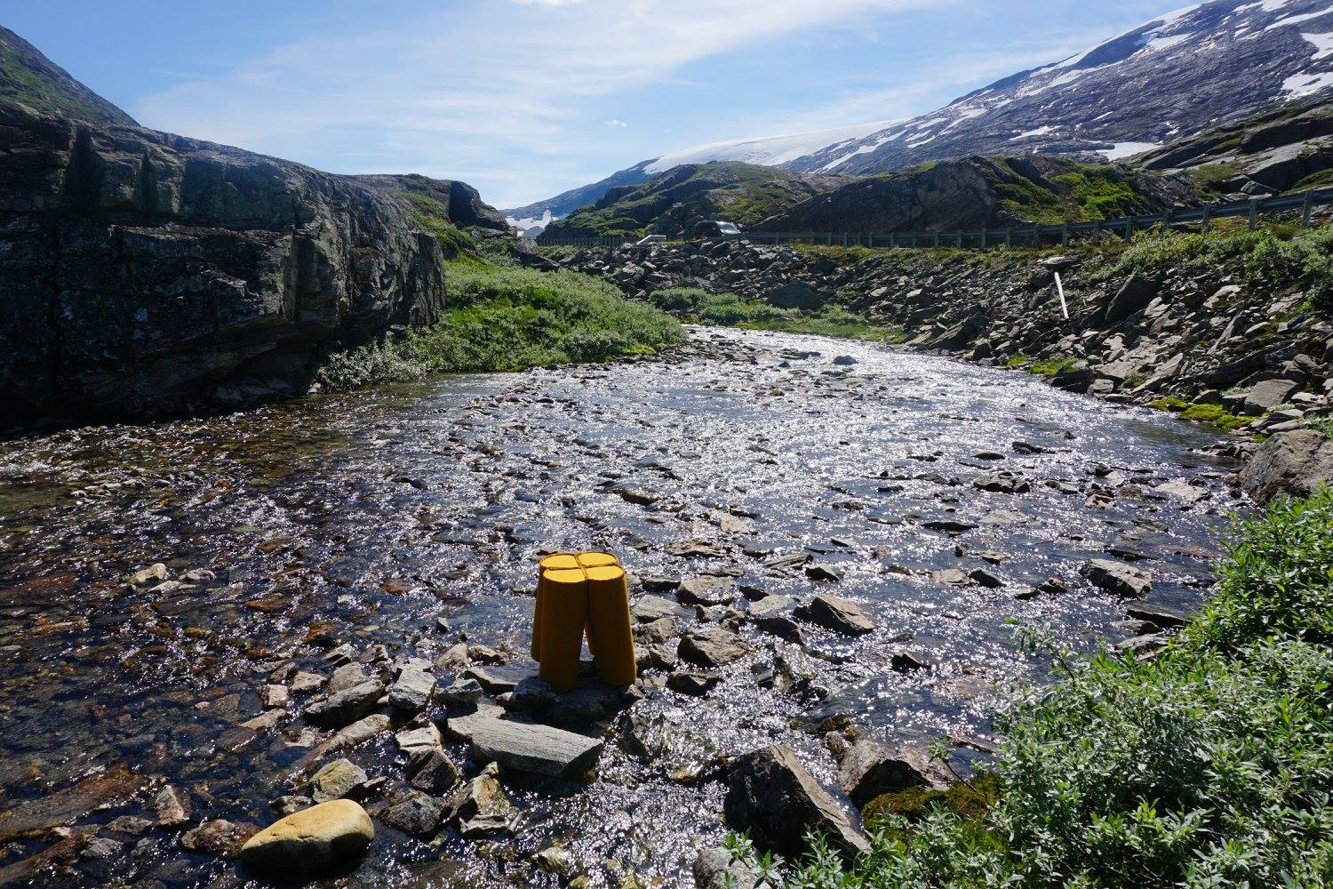
NOTI BY NATURE

Slide 9
We segregate and recycle the waste.
We responsibly manage the generated waste.
We optimise the processes, aiming at decreasing the waste amount.
NOTI manufactures products and packages, considering the possibility to recycle the elemental materials or its utilisation after the end of life cycle.
NOTI BY NATURE

Slide 10
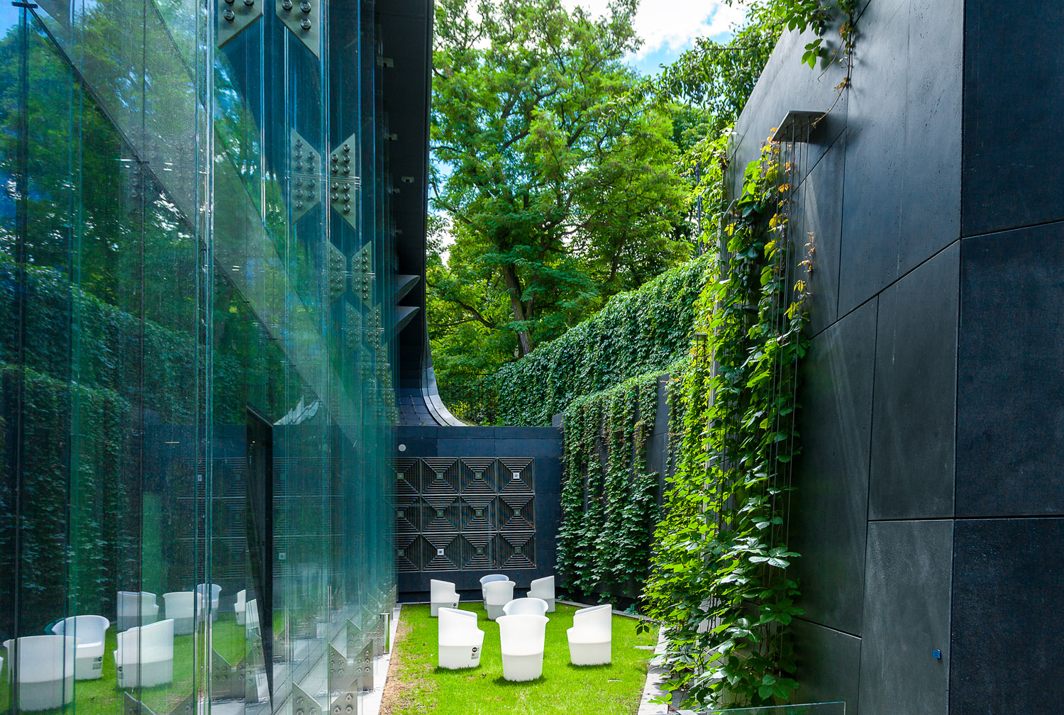
NOTI BY NATURE

Slide 11
In the production process of NOTI furniture, we apply the certified materials, such as: glues, foams, wood and wood-based materials.
The upholstery materials: fabric textiles and leathers are purchased from responsible and conscious suppliers.
Our materials are equipped with cerificates and hygiene and ecological certificates.
NOTI BY NATURE

Slide 12
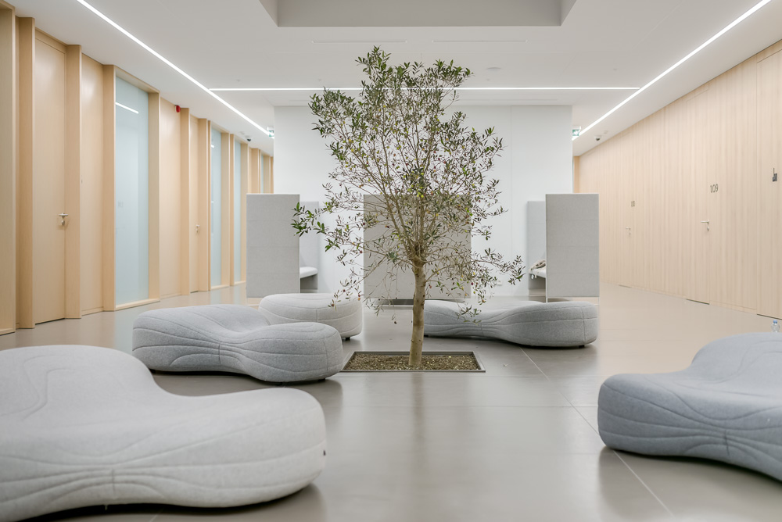
NOTI BY NATURE

Slide 13
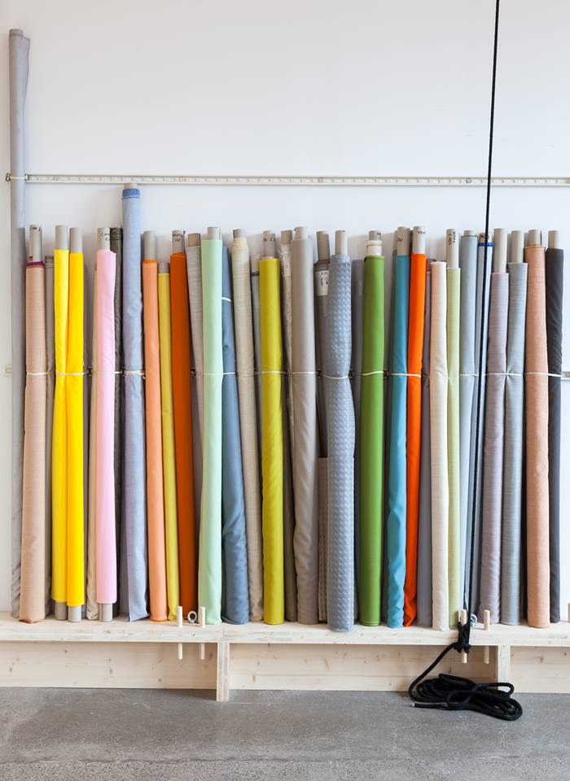
Our passion are textile covers. We use 2000 textile and leather kinds, from the best world suppliers, in the production process.
NOTI BY NATURE

Slide 14
The textile label marking, proving its sustainlability.
Oeko-Tex Standard 100
The reserved brand name, the certification for textile products.
The cetificate is awarded by International Association of Research and Testing in the field of Textile and Leather Ecology. It ensures the safety of textile products for a human being and the environment.
EU Ecolabel is the most important European award for products and services, which comply with the highest standards of the environment protection.
The program is supported by all EU governments and verified by solid and independent certification process.
Cradle to cradle - the certification „from cradle to cradle” means that products are created with the consideration of recycling while using industrial processes that minimalize the water usage, making use of the strategy of applying renewable energy, and taking into consideration social responsibility.
NOTI BY NATURE

Slide 15
The contract textiles marked Oeko-Tex Standard:
- Medley (Gabriel)
- Step & Step Melange (Gabriel) - Harper (Svensson)
The contract textiles marked Ecolabel:
- Remix 2 (Kvadrat) - Hallingdal 65 (Kvadrat)
- Step & Step Melange (Gabriel) - Blazer (Camira)
- Main Line Flax (Camira) - Patina (Camira)
NOTI BY NATURE

Slide 16
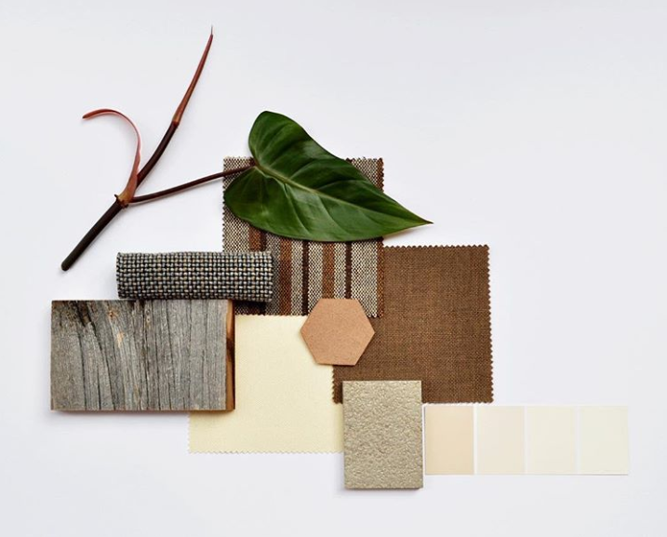
Pioneers of sustainable textile industry.
Designing products that do not impact the environment,
the integrated supply chain, the effective managing resources, human beings development and CSR
NOTI BY NATURE

Slide 17
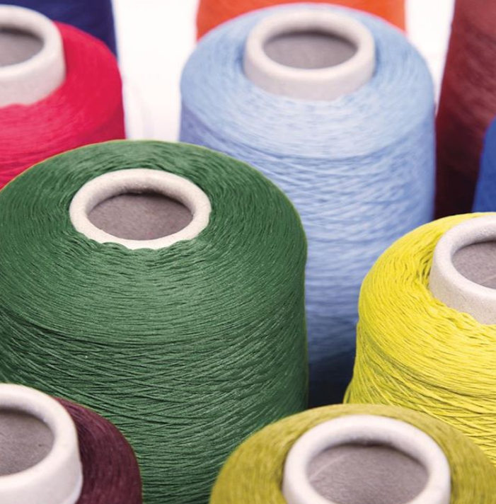
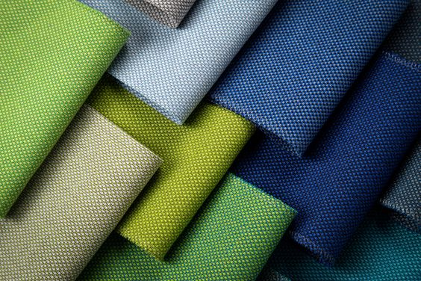
The sustainable development, responsibility, respect for the environment.
NOTI BY NATURE

Slide 18
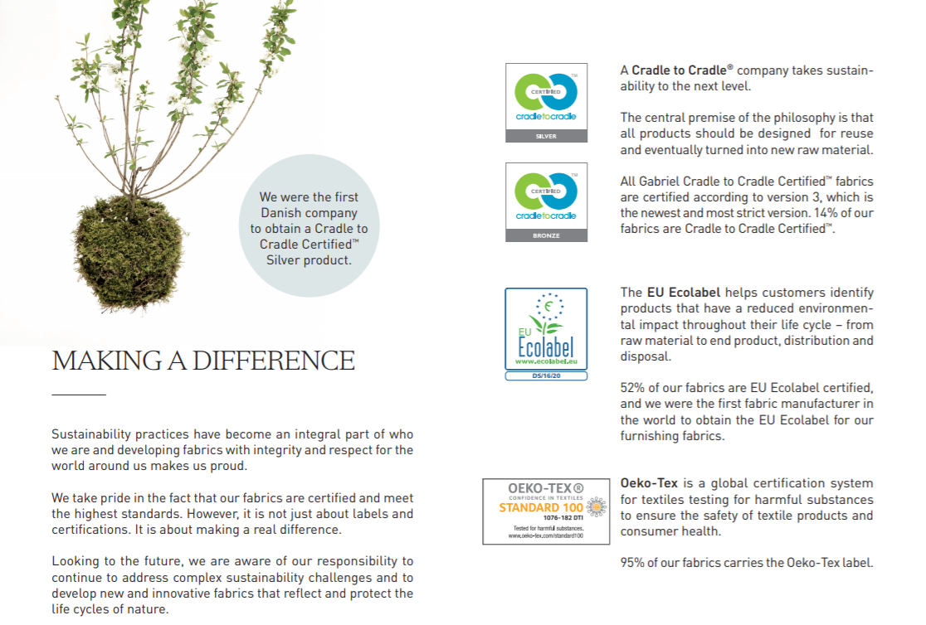
NOTI BY NATURE

Slide 19
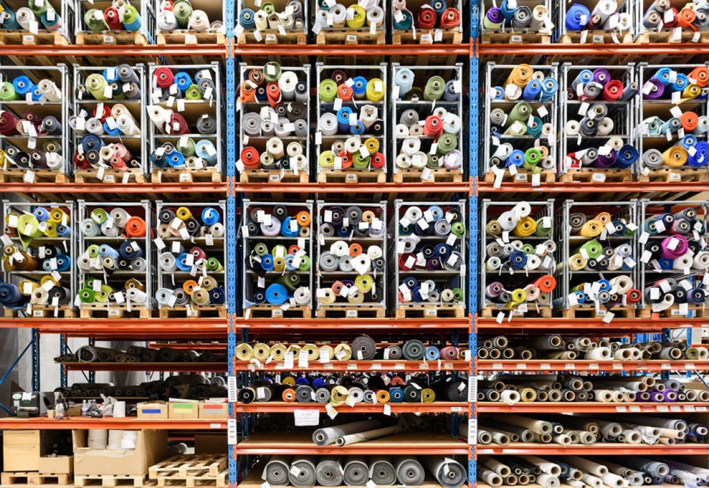
The attentiveness, sustainability, pursuit of reaching the optimal equilibrium between
the environment protection issues, precise quality standards, and social responsibility.
NOTI BY NATURE

Slide 20
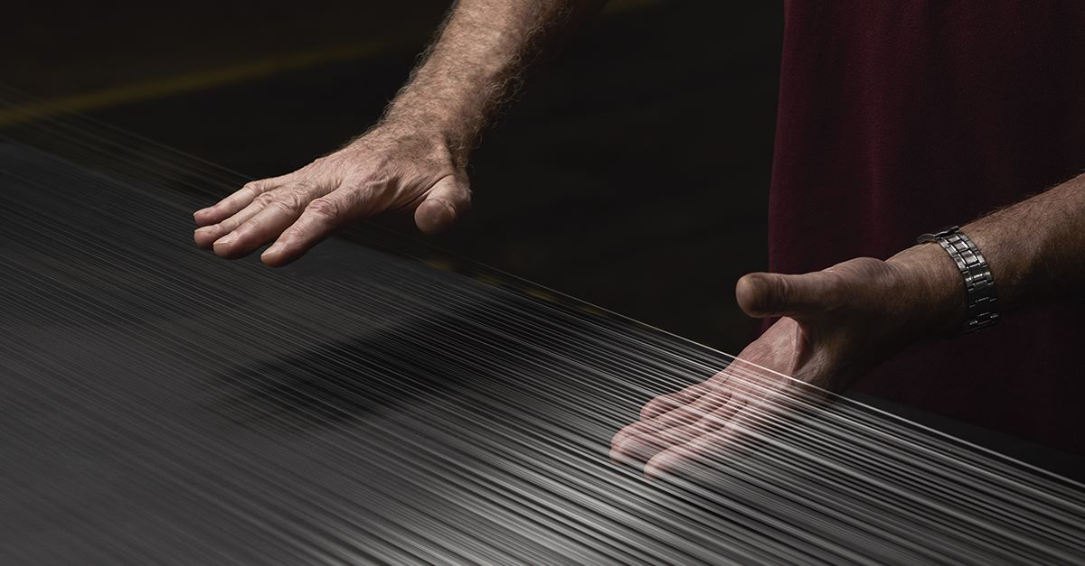
The pioneer and world leader in the field of climate control and energy effectiveness thanks to solutions based on textiles
NOTI BY NATURE

Slide 21
Create, manufacure and distribute flexible composite materials, remaining the innovation leader. Support the ecological construction.
NOTI BY NATURE

Slide 22
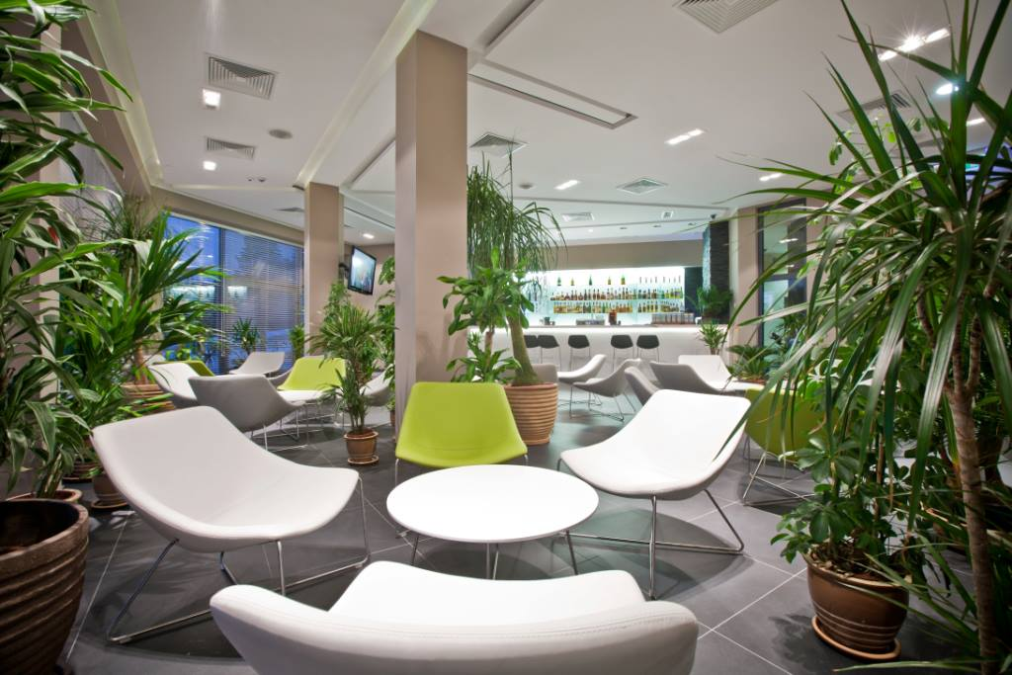
NOTI BY NATURE

Slide 23
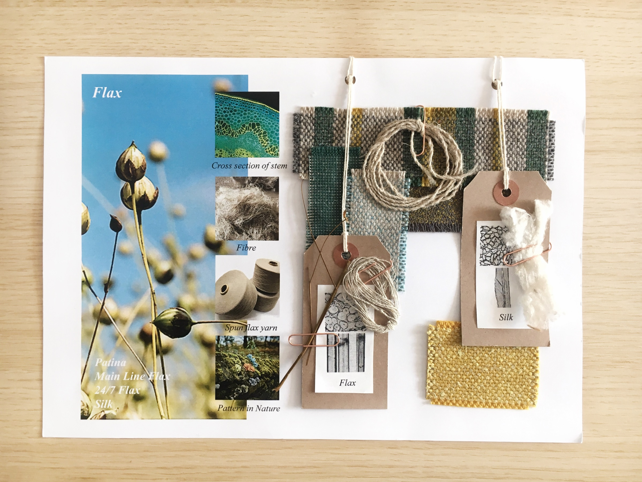
NOTI BY NATURE

Slide 24
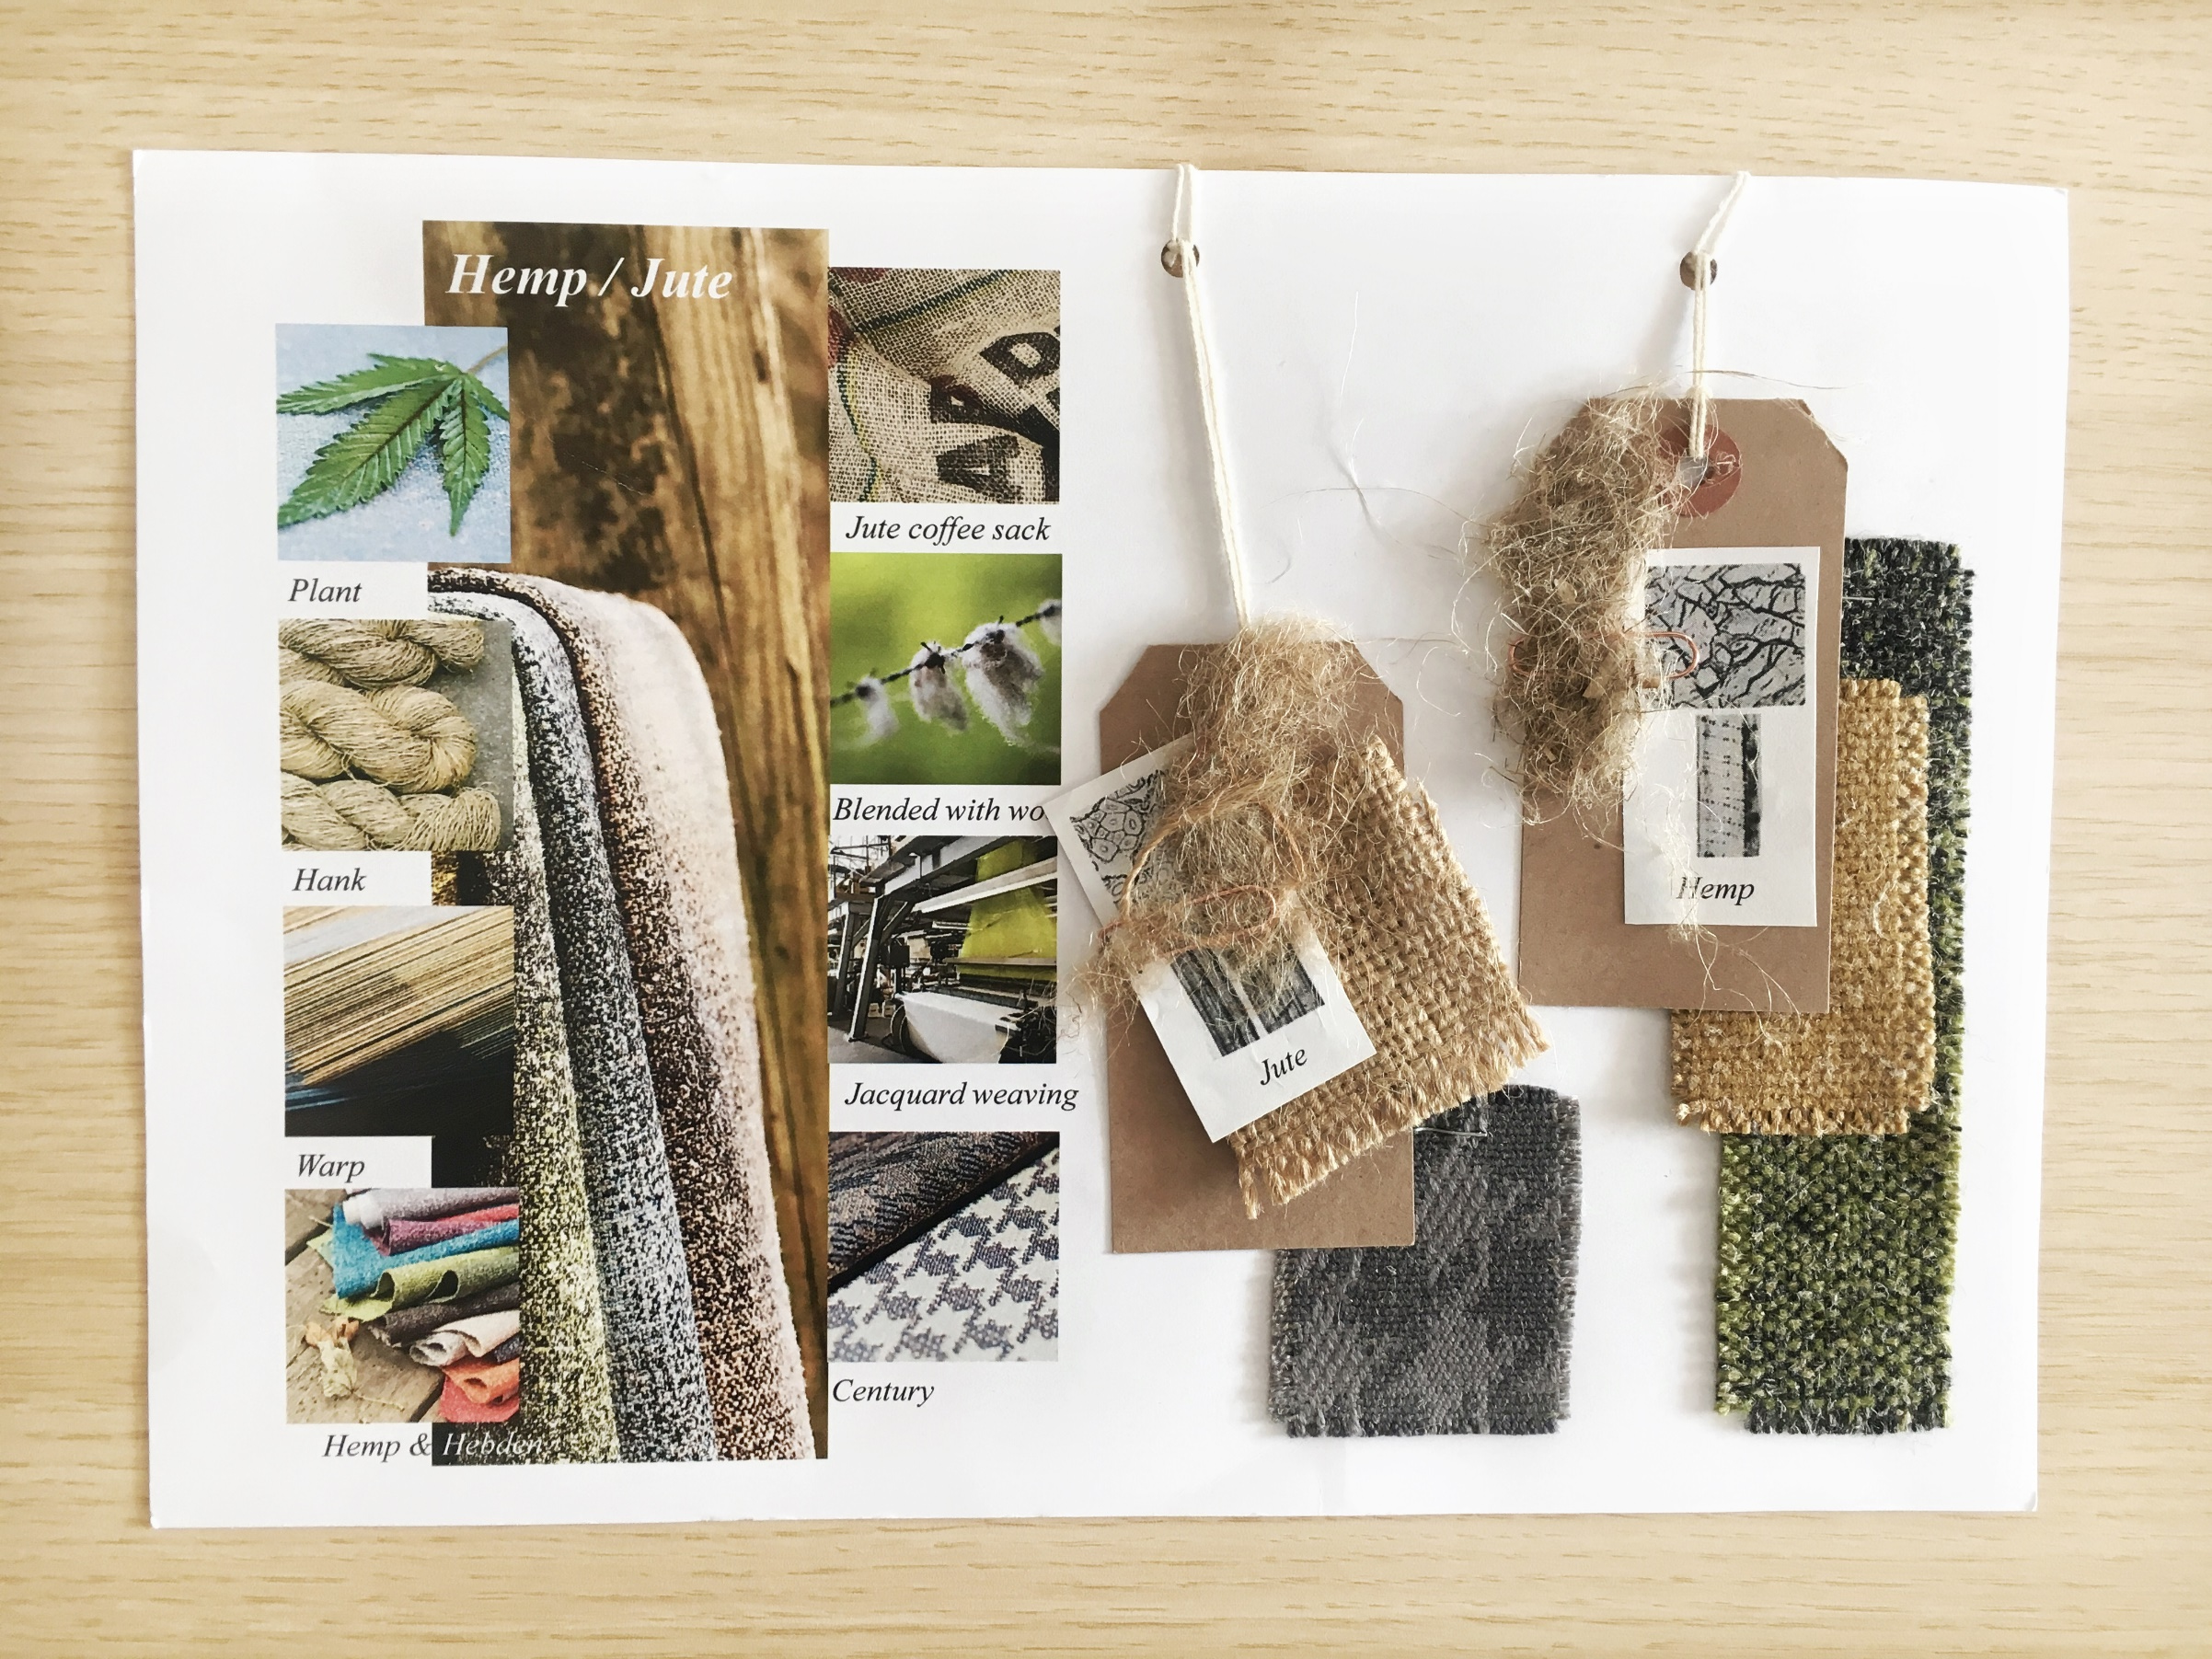
NOTI BY NATURE

Slide 25
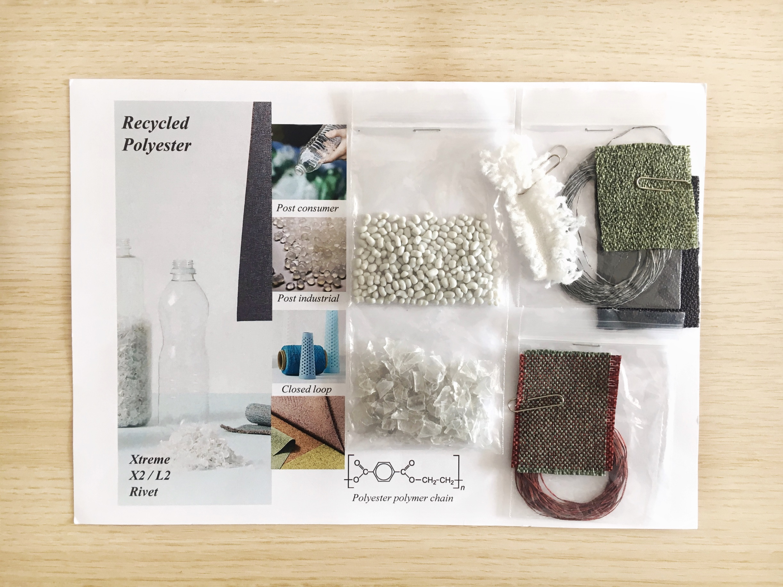
NOTI BY NATURE

Slide 26
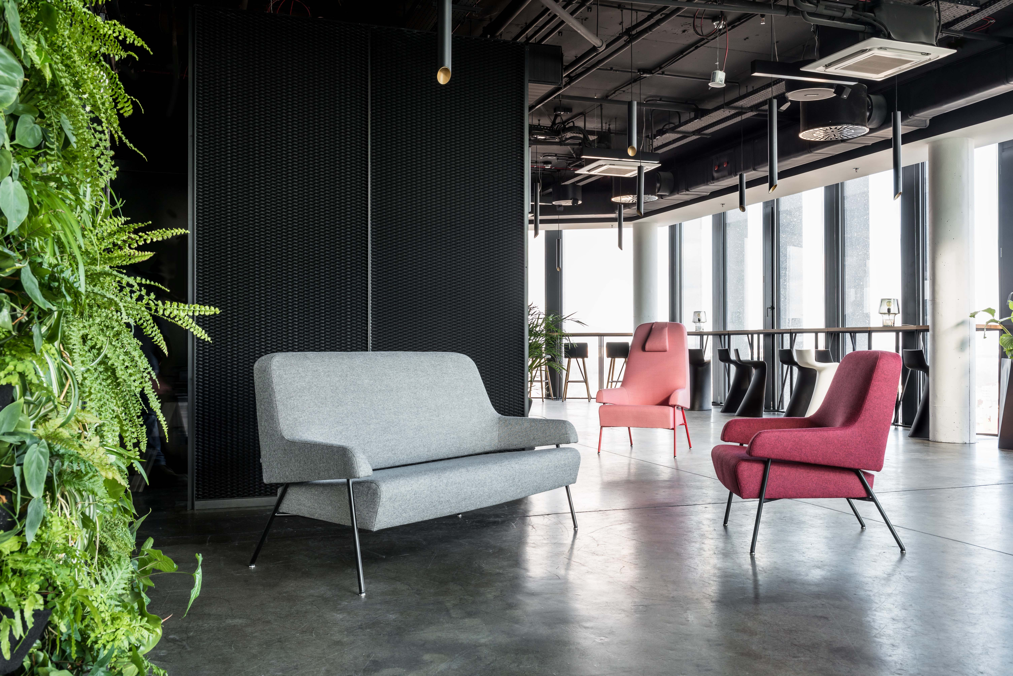
NOTI BY NATURE

Slide 27
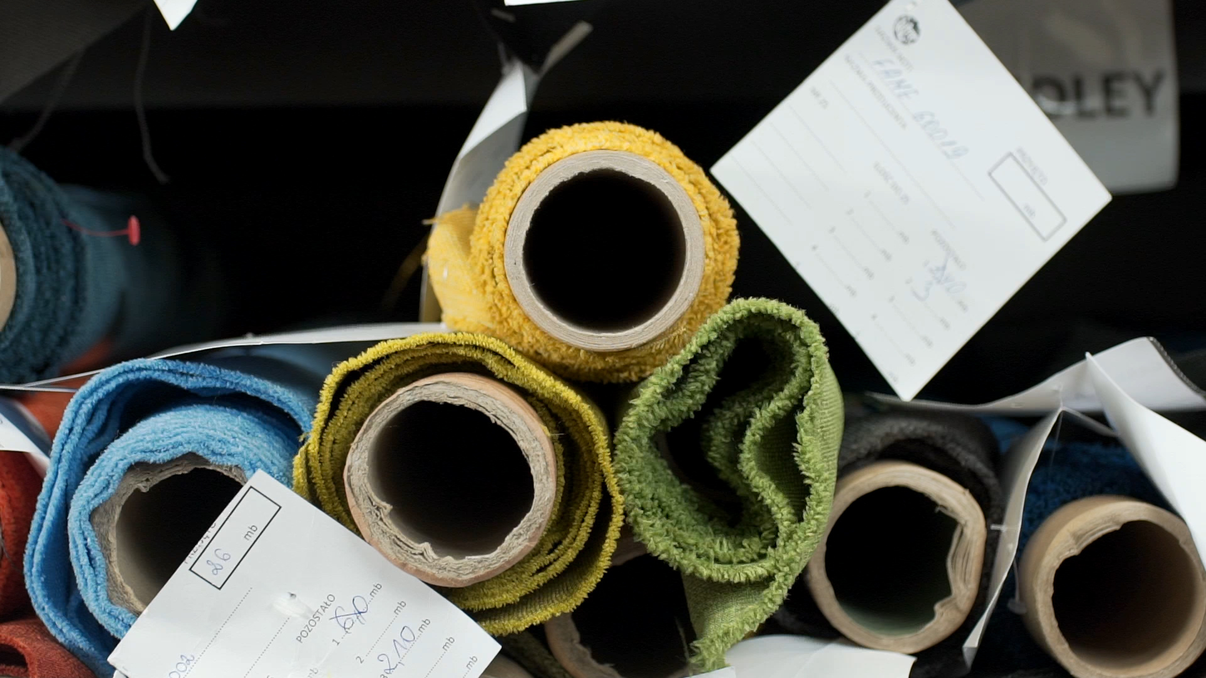
NOTI recycle all not used, in the production process, textile covers.
NOTI BY NATURE

Slide 28
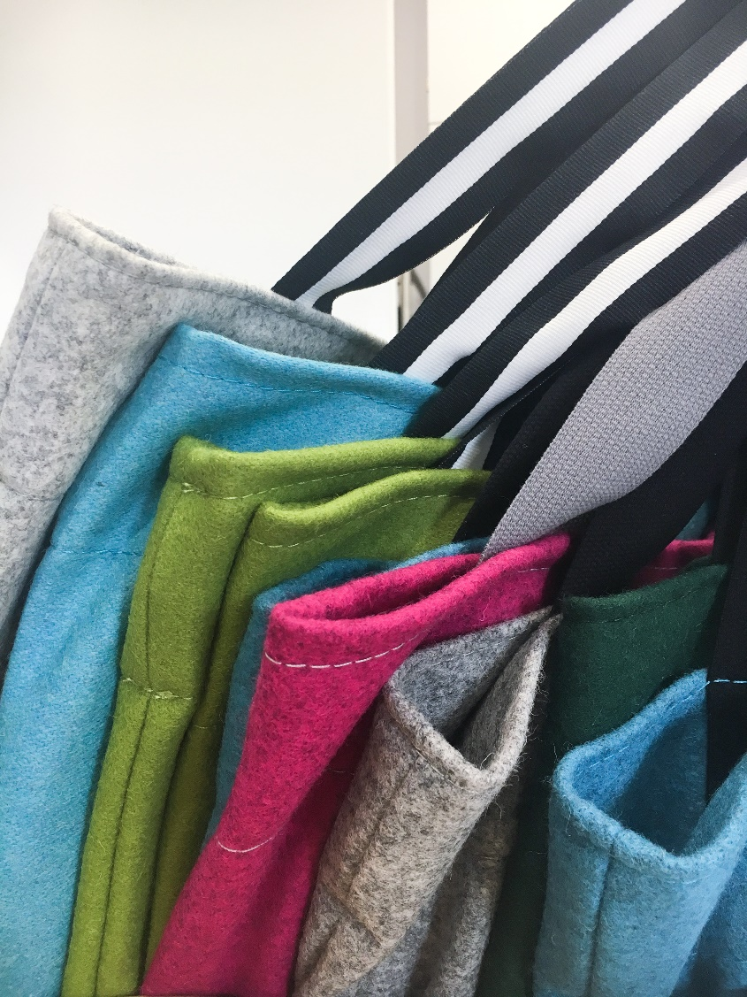
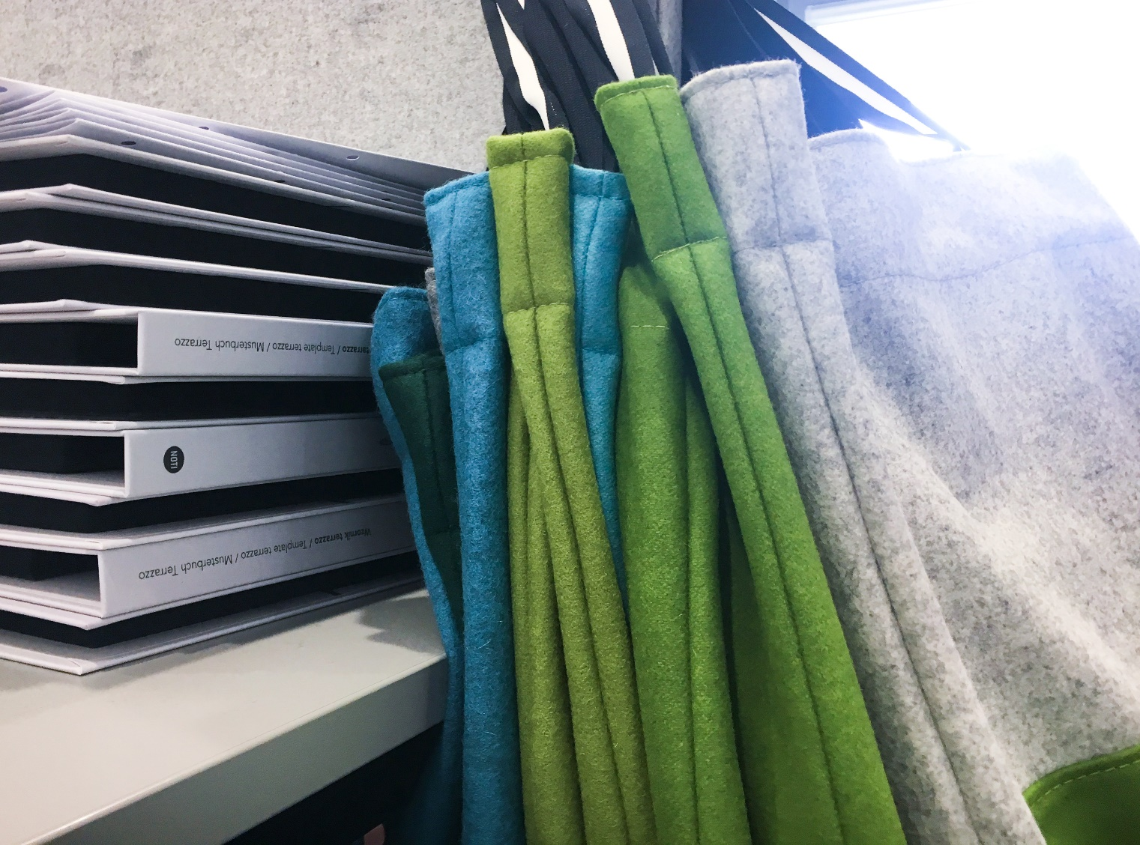
Textile leftovers are used in the production of NOTI marketing kits and during creative workshops while cooperating with Fine Arts Academies.
NOTI BY NATURE

Slide 29
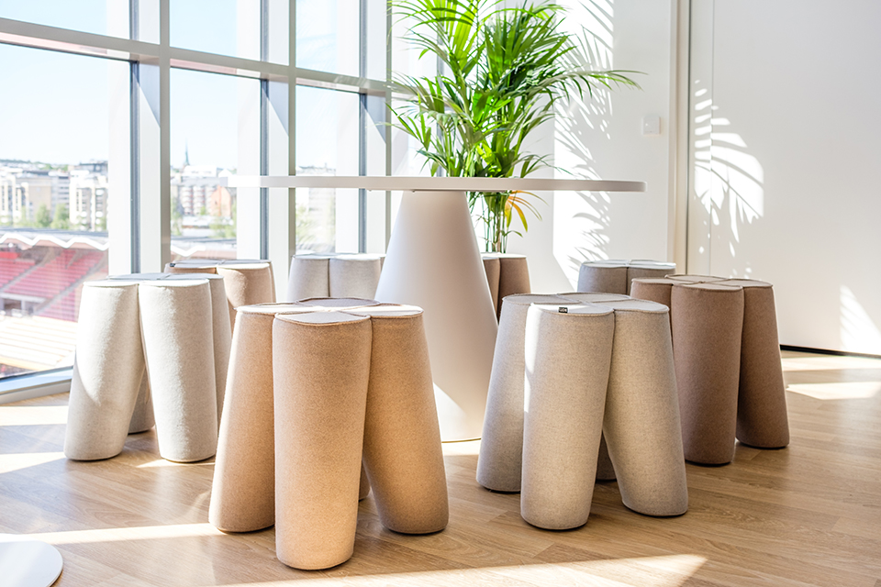
NOTI BY NATURE

Slide 30
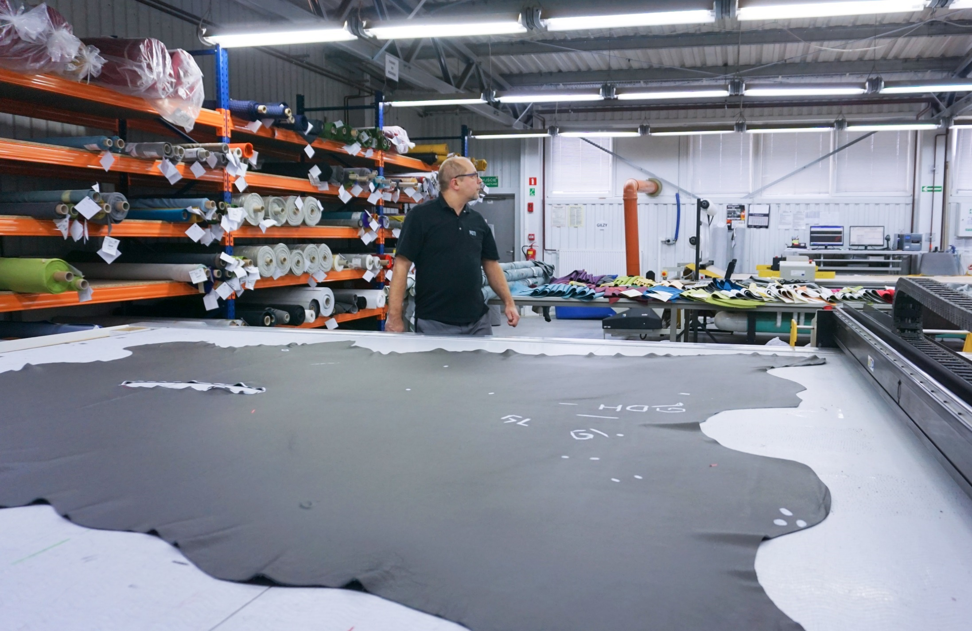
In the production process, we use CNC turning machines at the stage of cutting textile covers, leathers and plywood milling – it all helps to utilise the raw material in the most optimal way .
NOTI BY NATURE

Slide 31
Glues used in the production process of NOTI furniture possess certificates, proving the product security for a human being and the environment.
NOTI BY NATURE

Slide 32
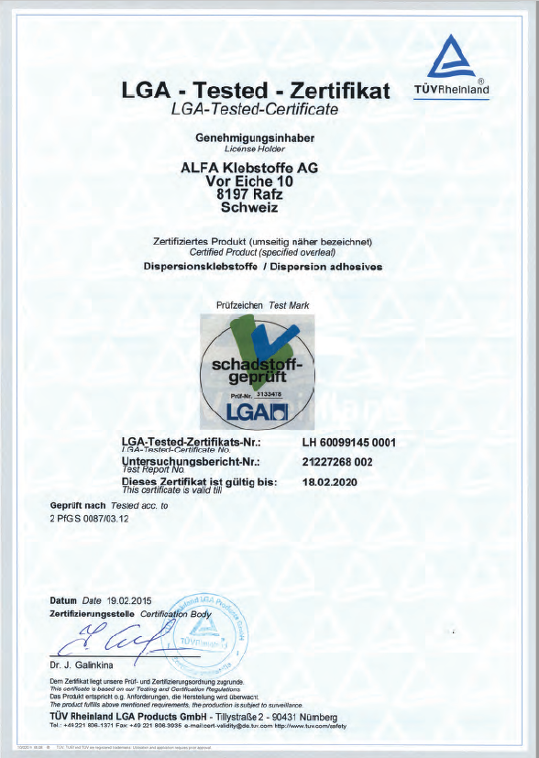
Water-soluble glue, without harmful volatile substances, possess the hygiene certificates.
The used glue-pots are adequately secured and disposed.
NOTI BY NATURE

Slide 33
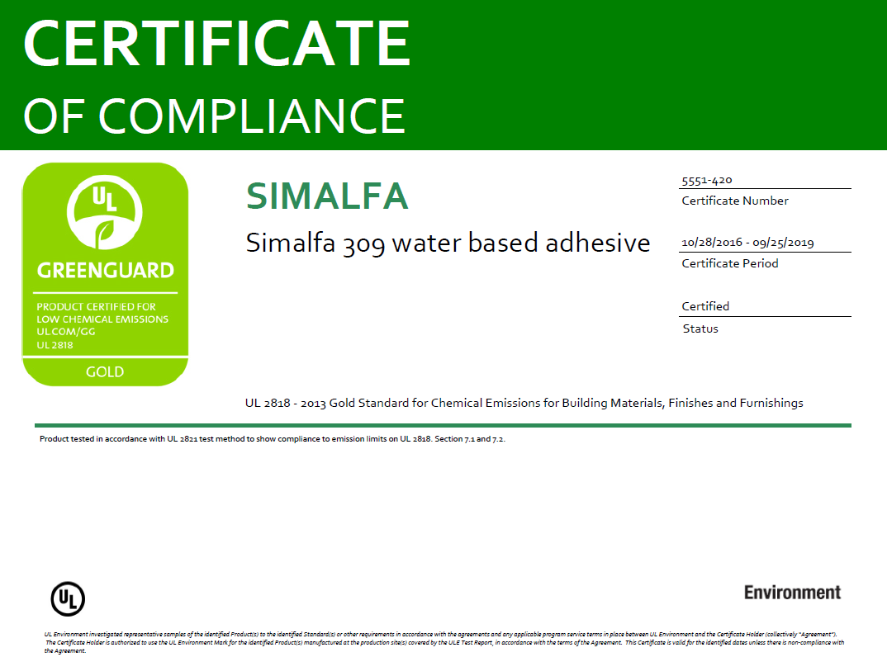
We use SIMALFA® glue, which is harmless for the environment.
NOTI BY NATURE

Slide 34
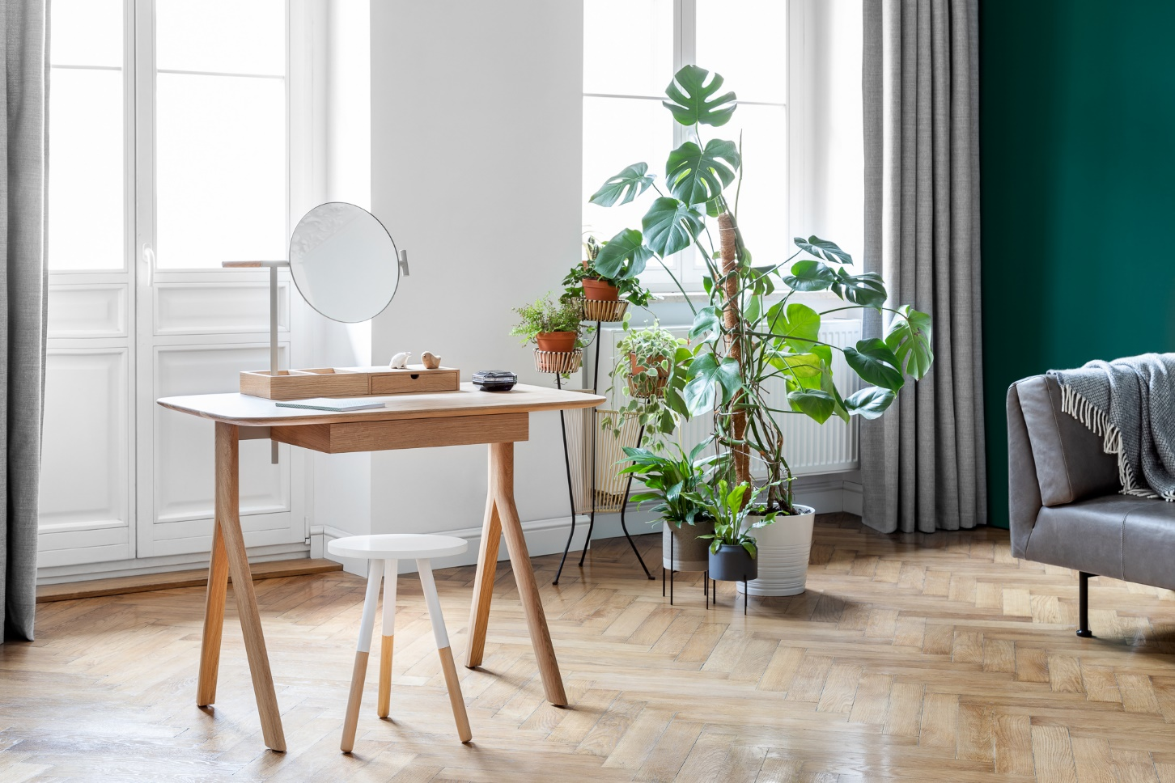
NOTI BY NATURE

Slide 35
In the technology of NOTI furniture manufacturing, we utilise wood and wood-based materials such as: MDF board, plywood and chipboard.
The wood raw materials come from certified sources.
NOTI BY NATURE

Slide 36
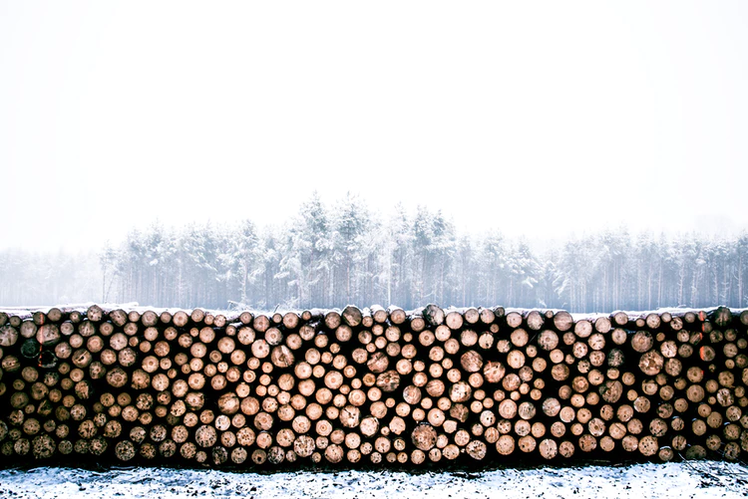
We regularly endeavour to acquire FSC certificate, which determines the appropriate and sustainable management of wood-based materials from the moment of processing the raw materials to manufacturing finished products. It also prevents from illegal acquiring wood-based materials, which protects forests and living animals there.
NOTI BY NATURE

Slide 37
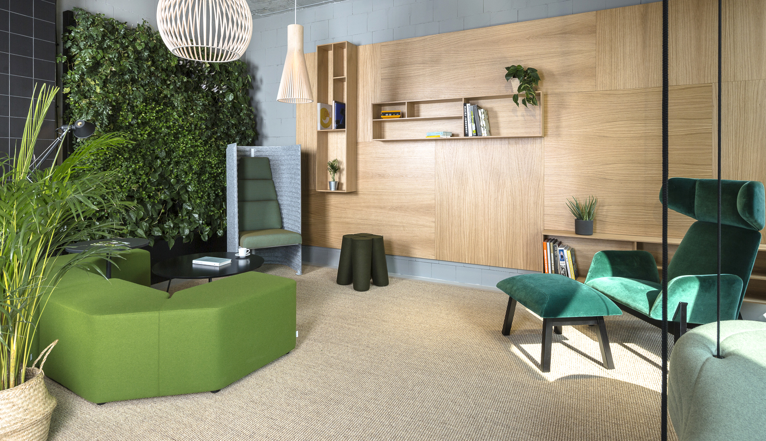
NOTI BY NATURE

Slide 38
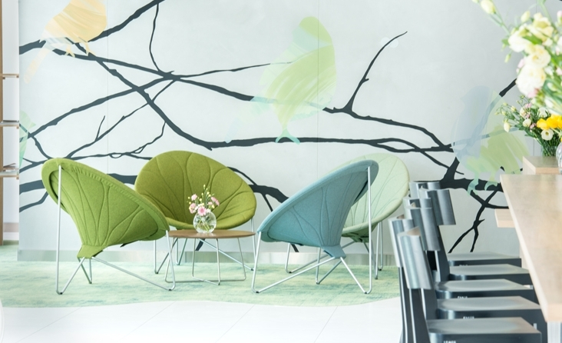
NOTI BY NATURE

Slide 39
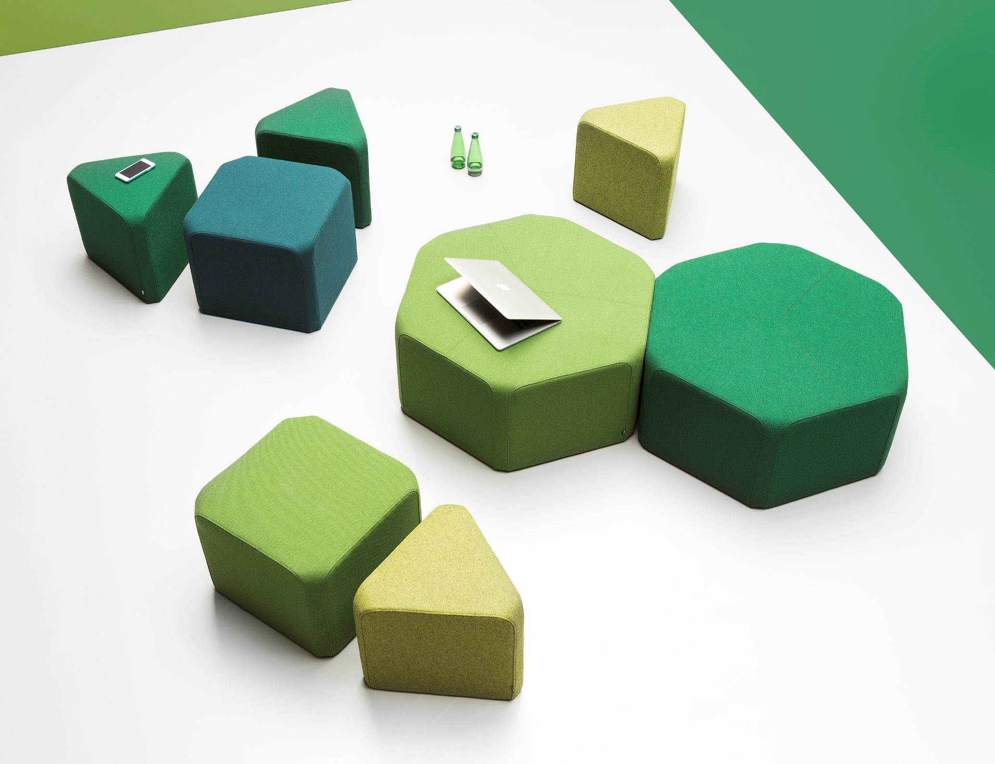
NOTI BY NATURE.

Slide 40
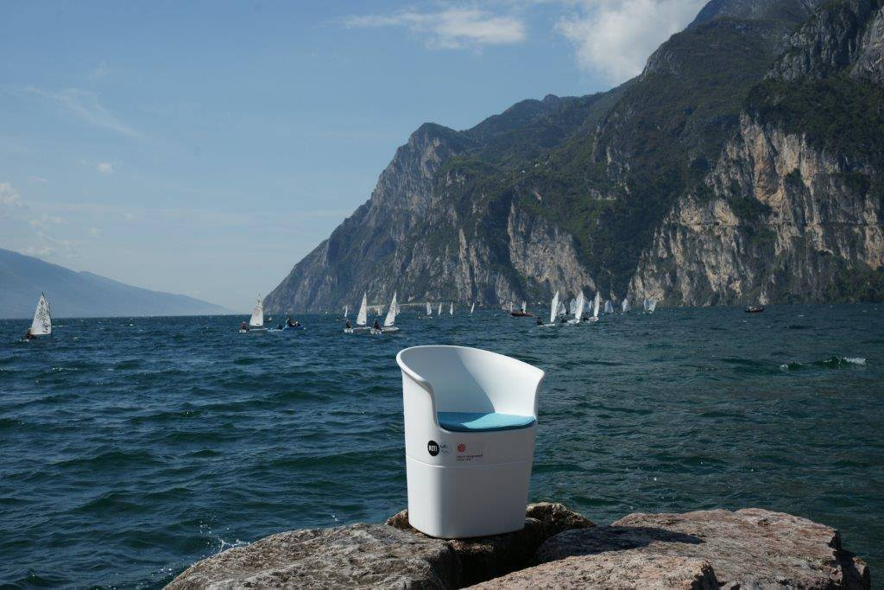
NOTI BY NATURE

Slide 41
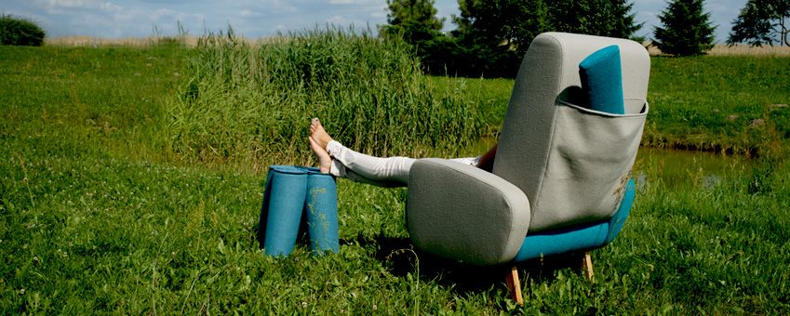
NOTI BY NATURE.

Slide 42
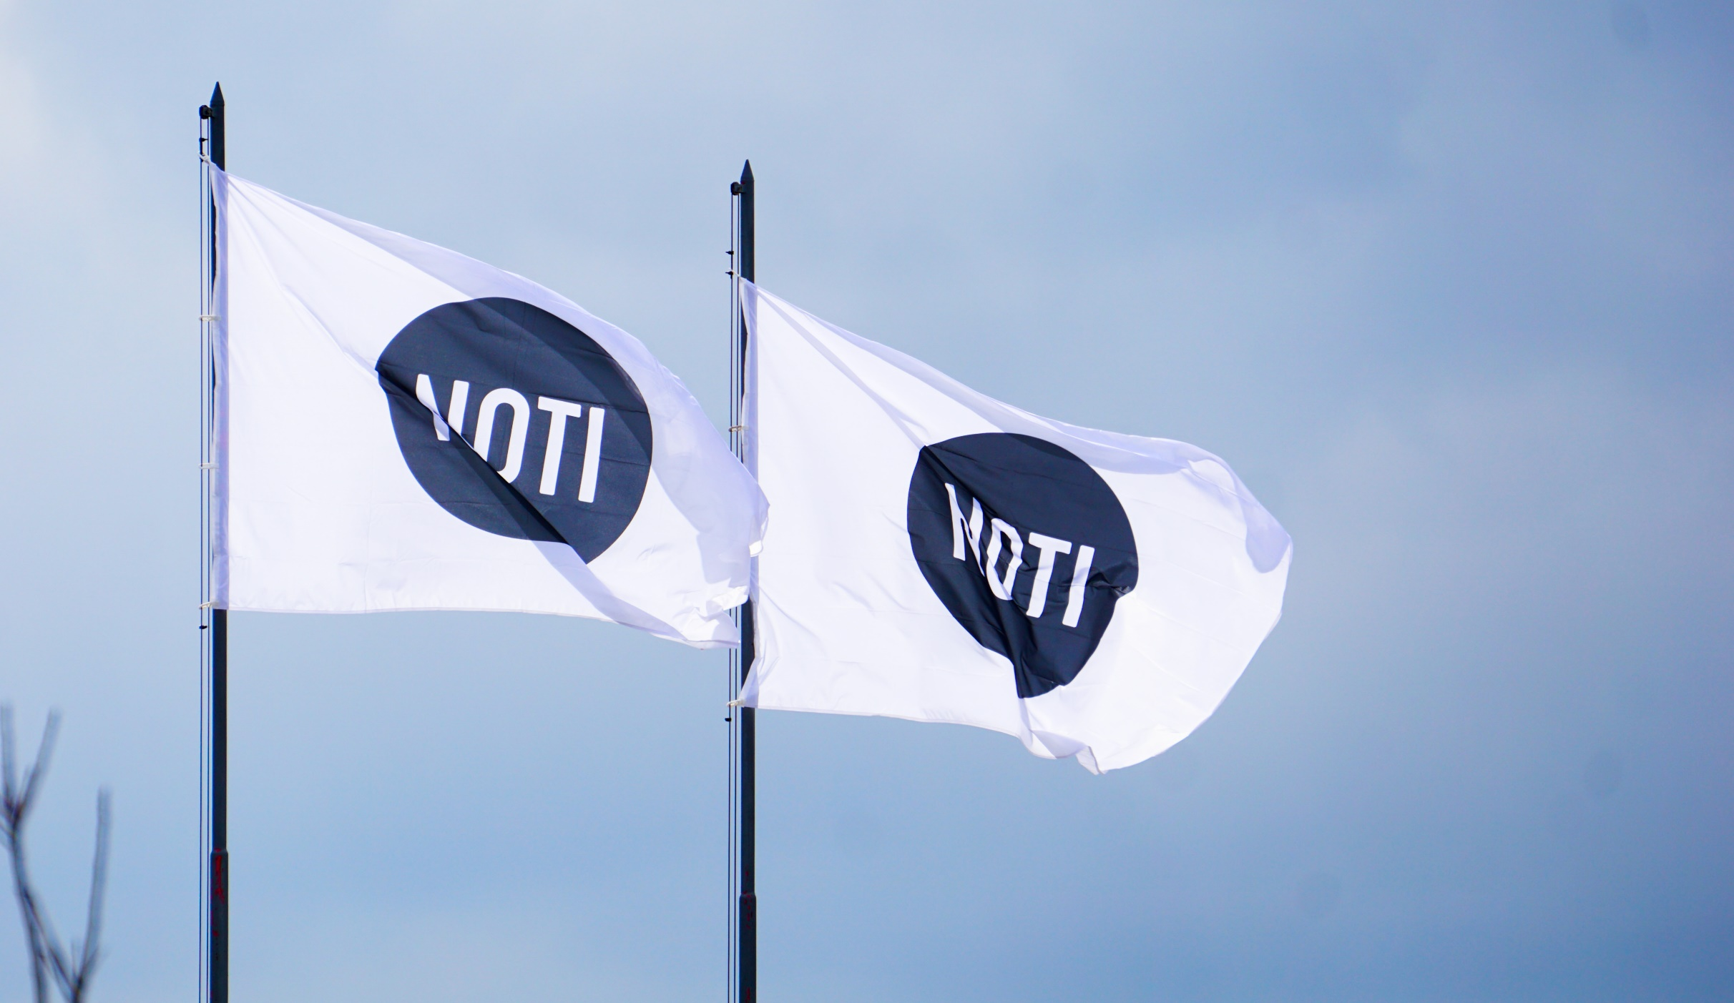
NOTI BY NATURE

Slide 43
Noti Ltd
Sowia 19 Street
62 -080 Tarnowo Podgórne
POLAND
T: +48 61 89 66 480
sale@noti.pl
marketing@noti.pl
www.noti.pl
facebook.com/mebleNOTI/
instagram.com/noti_furniture_brand/
pinterest.com/NOTI_furniture/

